Slide 1

Melanoma Classification Using Dermoscopic Image

Slide 2

Group Members
MUQADAS HUMA MSCSF24M007
MARYAM ATTAULLAH MSCSF24M009
KHADIJA ANSARI MSCSF24M019
NIGHAT RANI MSCSF24M020

Slide 3

Table of contents
Introduction
Data Set
Literature Review
Methodology
Evaluation
Performance Comparison
Conclusion
References

Slide 4
01 Introduction

Slide 5
What is Skin Lesion
Skin lesion is a general term for any abnormal growth, bump, spot, or other mark on the skin, such as a mole, freckle, or rash.
Skin lesions can be caused by a number of things, including injuries, sun damage, infections, or autoimmune diseases.

Slide 6
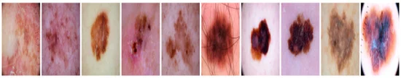
Types of skin lesion
Melanoma :
A dangerous type of skin cancer that originates in melanocytes and can quickly spread to other parts of the body if not treated early.

Slide 7

CONT:
Benign :
A non-cancerous skin growth that is generally harmless and does not spread, often appearing as regular moles or skin tags

Slide 8
02 Problem Statement

Slide 9
Our Agenda
This project aims to address the following:
Develop an automated tool that can assist dermatologists by accurately distinguishing between benign and malignant skin lesions using dermoscopic images.
Evaluate the performance of model to ensure accuracy perfectly meets clinic standard's.

Slide 10
02 Literature Review

Slide 11
Cont.
Ali et al. (2021): This paper presents an enhanced DCNN model for skin cancer classification, evaluated against popular transfer learning models (e.g., ResNet, VGG-16). Using the HAM10000 dataset, the authors employed preprocessing steps such as noise removal, normalization, and data augmentation to improve model performance, achieving a high classification accuracy of 91.43% on test data. Their use of data augmentation and specialized feature extraction techniques in DCNN provides a reliable method for early skin cancer detection. This study highlights the advantages of DCNN over existing models, emphasizing the need for robust preprocessing and balanced data handling in dermatological image analysis..

Slide 12
Cont.
Kassem et al. (2021): This systematic review explores both ML and DL approaches for skin lesion classification, highlighting advancements, challenges, and the effectiveness of different methodologies. Using datasets like ISIC and PH2, the study finds that DL models, particularly CNNs and transfer learning methods, significantly improve diagnostic accuracy over traditional ML methods. Preprocessing techniques, such as noise reduction and data augmentation, enhance image quality, while ensemble methods help overcome individual model limitations. The review underscores the importance of explain ability in DL models and advocates for balanced, diverse datasets to improve model robustness. This comprehensive overview of CAD systems provides a strong foundation for developing skin cancer detection models, as seen in recent DL advancements.

Slide 13
03 Data Set

Slide 14
Melanoma Skin Cancer Dataset of 10000 Images
Melanoma Skin Cancer Dataset contains 10,000 images. Melanoma skin cancer is deadly cancer, early detection and cure can save many lives. This dataset will be useful for developing the models for accurate classification of melanoma.
Dataset consists of 9600 images for training the model and 1000 images for evaluation of model.

Slide 15
Our Data SET Description
Total Images: Approximately 5000 images.
Classes: Melanoma(1), Benign(0)
Resolution: Varies, but most images are high resolution, allowing detailed examination.

Slide 16
04 Methodology

Slide 17
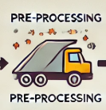
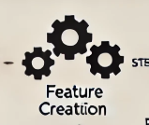
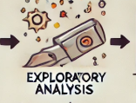

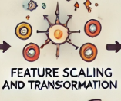
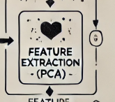
Executive Summary
Resize
Gray Scale
Smoothing
Hair remove
Roi extraction
Skew ness
Histogram
Scaling
Principle Component Analysis(PCA)
First Order
Second Order
Lbp Feature
Shape
Edge Feature
Handling-missing values
Correlation-matrix

Slide 18
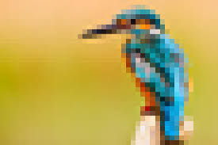
Preprocessing

Slide 19
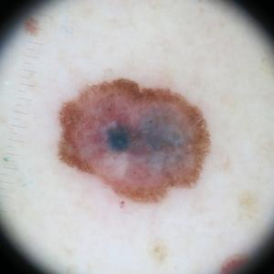
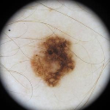
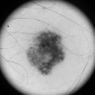
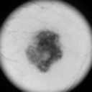
Preprocessing
Original Image
Resize
(128, 128, 3)
Gray-Scale
(128, 128)
Smoothing
Median-blur
To remove Salt and pepper noise

Slide 20
Hair Removal
Step 01: Morphological Black-hat Transformation
Process: The Black-hat morphological operation is applied to enhance thin, dark structures (like hair) against a lighter background.
A filtering step ensures that small irrelevant structures are suppressed, and dilation is applied to connect fragmented regions.
Output: An image where hair-like features are highlighted, while background and noise are suppressed.

Slide 21
Cont.
Step 2: Focus on Darker Regions
Process: A binary mask is created to isolate darker regions in the image (as hair typically appears darker than the background). This mask is refined through morphological operations to smooth and connect regions.
Output: A refined mask that isolates darker regions, enhancing the contrast of potential hair structures.

Slide 22
Cont.
Step 3: Detecting Hair-like Lines
Process: A line-detection algorithm is applied to identify elongated structures resembling hair. Short lines that do not meet the required length are discarded. The remaining lines are analyzed and stored for further processing.
Output: A set of detected lines that represent hair-like structures

Slide 23
Cont.
Step 4: Creating a Mask for Hair Regions
Process: A binary mask is generated based on the detected hair-like lines. This mask is validated to ensure it meets specific criteria:
Output: A validated mask highlighting the regions identified as hair. If no valid hair is detected, the mask remains empty.

Slide 24
Cont.
Step 5: Interpolation to Remove Hair
Process: Regions corresponding to the hair mask are replaced with interpolated pixel values. Interpolation uses nearby pixels to estimate the intensities of the masked areas, ensuring smooth reconstruction.
Output: A cleaned image where hair artifacts are replaced by smoothly interpolated values. This function return clean image and it’s respective binary mask.

Slide 25
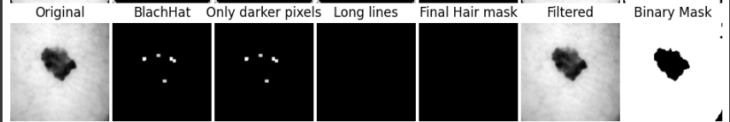
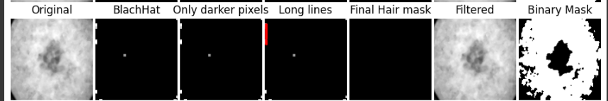
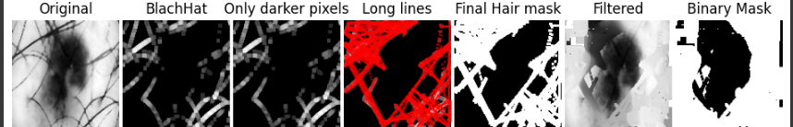
Cont.

Slide 26
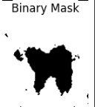
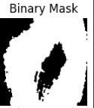




Extraction of REGION OF INTEREST (ROI)
Filtering Small Objects in Binary Mask:
A cleaned binary mask where:
Small objects (noise) have been removed and objects near the image's center are retained

Slide 27
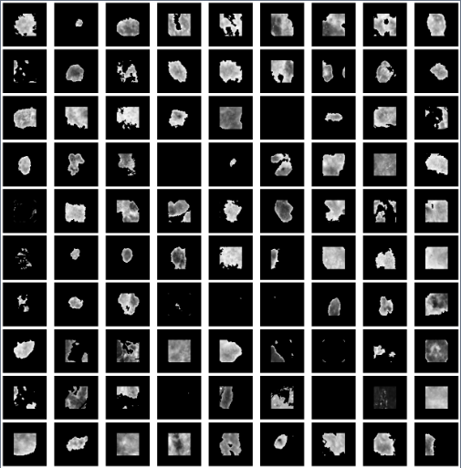
Extraction of REGION OF INTEREST (ROI)

Slide 28
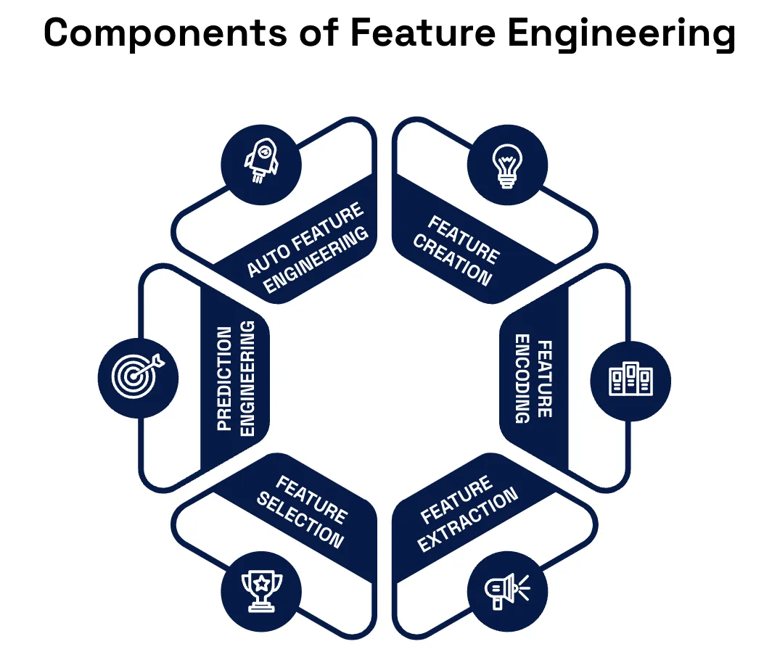
FEATURE ENGINEERING

Slide 29
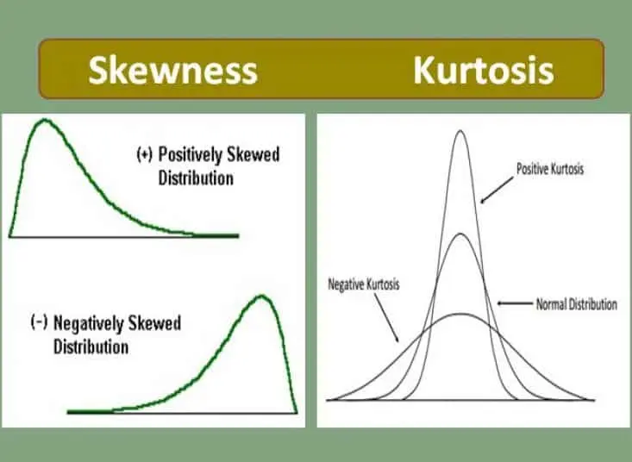
Feature Creation
First-Order Features
These features provide statistical descriptions of the
pixel intensity distribution in an image. They are calculated using the raw pixel intensities.
Mean: The mean calculates the average intensity of all pixels in the image. : Variance: measures how spread out the intensity values are from the mean.
Standard Deviation: The square root of variance, it represents the intensity fluctuation
Skew-ness: Skew-ness describes the asymmetry of the intensity distribution.
Kurtosis: Kurtosis quantifies the "tailedness" of the intensity distribution.
Entropy: Entropy calculates the randomness of pixel intensities.

Slide 30
Cont.
Second-Order Features (GLCM)
Texture features describe how pixel intensities relate to one another spatially. The Gray-Level Co-occurrence Matrix (GLCM) calculates how often pairs of pixel intensities (gray levels) occur at a specific distance and angle.
Contrast:
Measures the difference in intensity between neighboring pixels. High contrast values indicate sharp transitions (e.g., edges, rough textures), while low values suggest uniform or smooth areas.
Energy:
Represents the uniformity of the texture. High energy indicates repetitive or uniform patterns, while low energy suggests irregular or complex textures.
.

Slide 31
Cont.
Homogeneity: Measures the similarity of adjacent pixel intensities. High homogeneity indicates smooth regions with little variation, while low homogeneity suggests textured or noisy areas.
Correlation: Describes the linear relationship between pixel pairs. High correlation means neighboring pixels have similar intensities (e.g., smooth gradients), while low correlation suggests randomness or noise

Slide 32
CONT.
Local Binary Pattern (LBP) Features
LBP captures local texture patterns by comparing a pixel’s intensity to its neighbors.
What it calculates: The LBP value for each pixel is a binary number based on whether the neighboring pixels are brighter or darker than the center pixel. The result is a texture "map" of the image.
LBP Histogram: By summarizing the LBP values into a histogram,
Mean
Standard deviation
Skew-ness

Slide 33
Cont.
Shape Features
Shape features describe the geometry and boundary properties of objects in a binary image (regions of interest).
Area: The total number of pixels within an object. It indicates the size of the region.
Perimeter: The length of the object's boundary. It measures how "complex" the boundary is. An object with a jagged boundary will have a longer perimeter than a smooth object of similar area.
Eccentricity: Measures how elongated an object is.
Eccentricity ≈0: The object is circular.
Eccentricity ≈1: The object is elongated or elliptical.

Slide 34
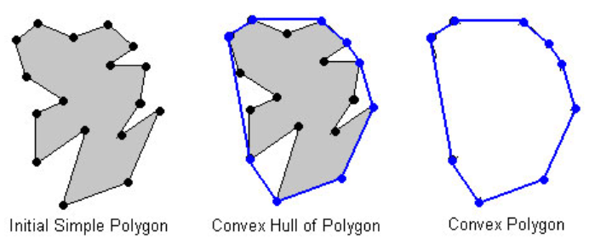
Cont.
Solidity: Compares the area of the object to the area of its convex hull (the smallest convex shape that can enclose the object).
High solidity (≈1): The object is compact and filled.
Low solidity (<1): The object is irregular or has gaps.
Circularity: Describes how close the object is to a perfect circle.
Circularity =1: The object is a perfect circle.
Lower values indicate irregular or elongated shapes.
Roughness: Quantifies boundary irregularities by comparing the object's perimeter to its convex hull perimeter.

Slide 35
Cont.
Hu Moments:
Hu Moments are a set of seven shape descriptors derived from image moments, which capture spatial information about the pixel intensities of an object in an image Derived from moments of the image.
Hu Moments=∑[Moments of pixel intensities]/n
Edge Features
Edge Density: Proportion of edge pixels in the image: Edge-Density=Number of Edge Pixels/Total
Total Feature length is 43.

Slide 36

Exploratory Analysis

Slide 37

Handling Missing Values
Skew-ness measures the asymmetry of the data distribution. If the data in the image is uniform (i.e., all pixel values are the same), it could lead to a zero variance or an undefined skew-ness, causing the result to be null or undefined.
Roughness typically involves calculating the variation in pixel intensities across the image. If the image is entirely smooth (i.e., pixel values are identical), roughness might be ill-defined.

Slide 38
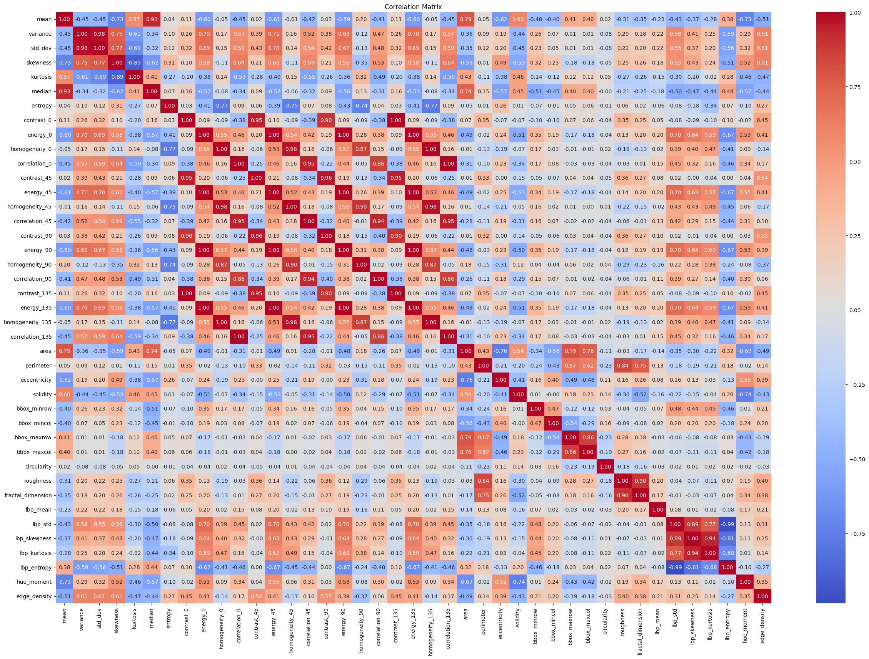
Correlation Matrix
Dark Red Color :
Feature are positive correlated to each other.
Dark Blue:
Features are negatively related to each other

Slide 39
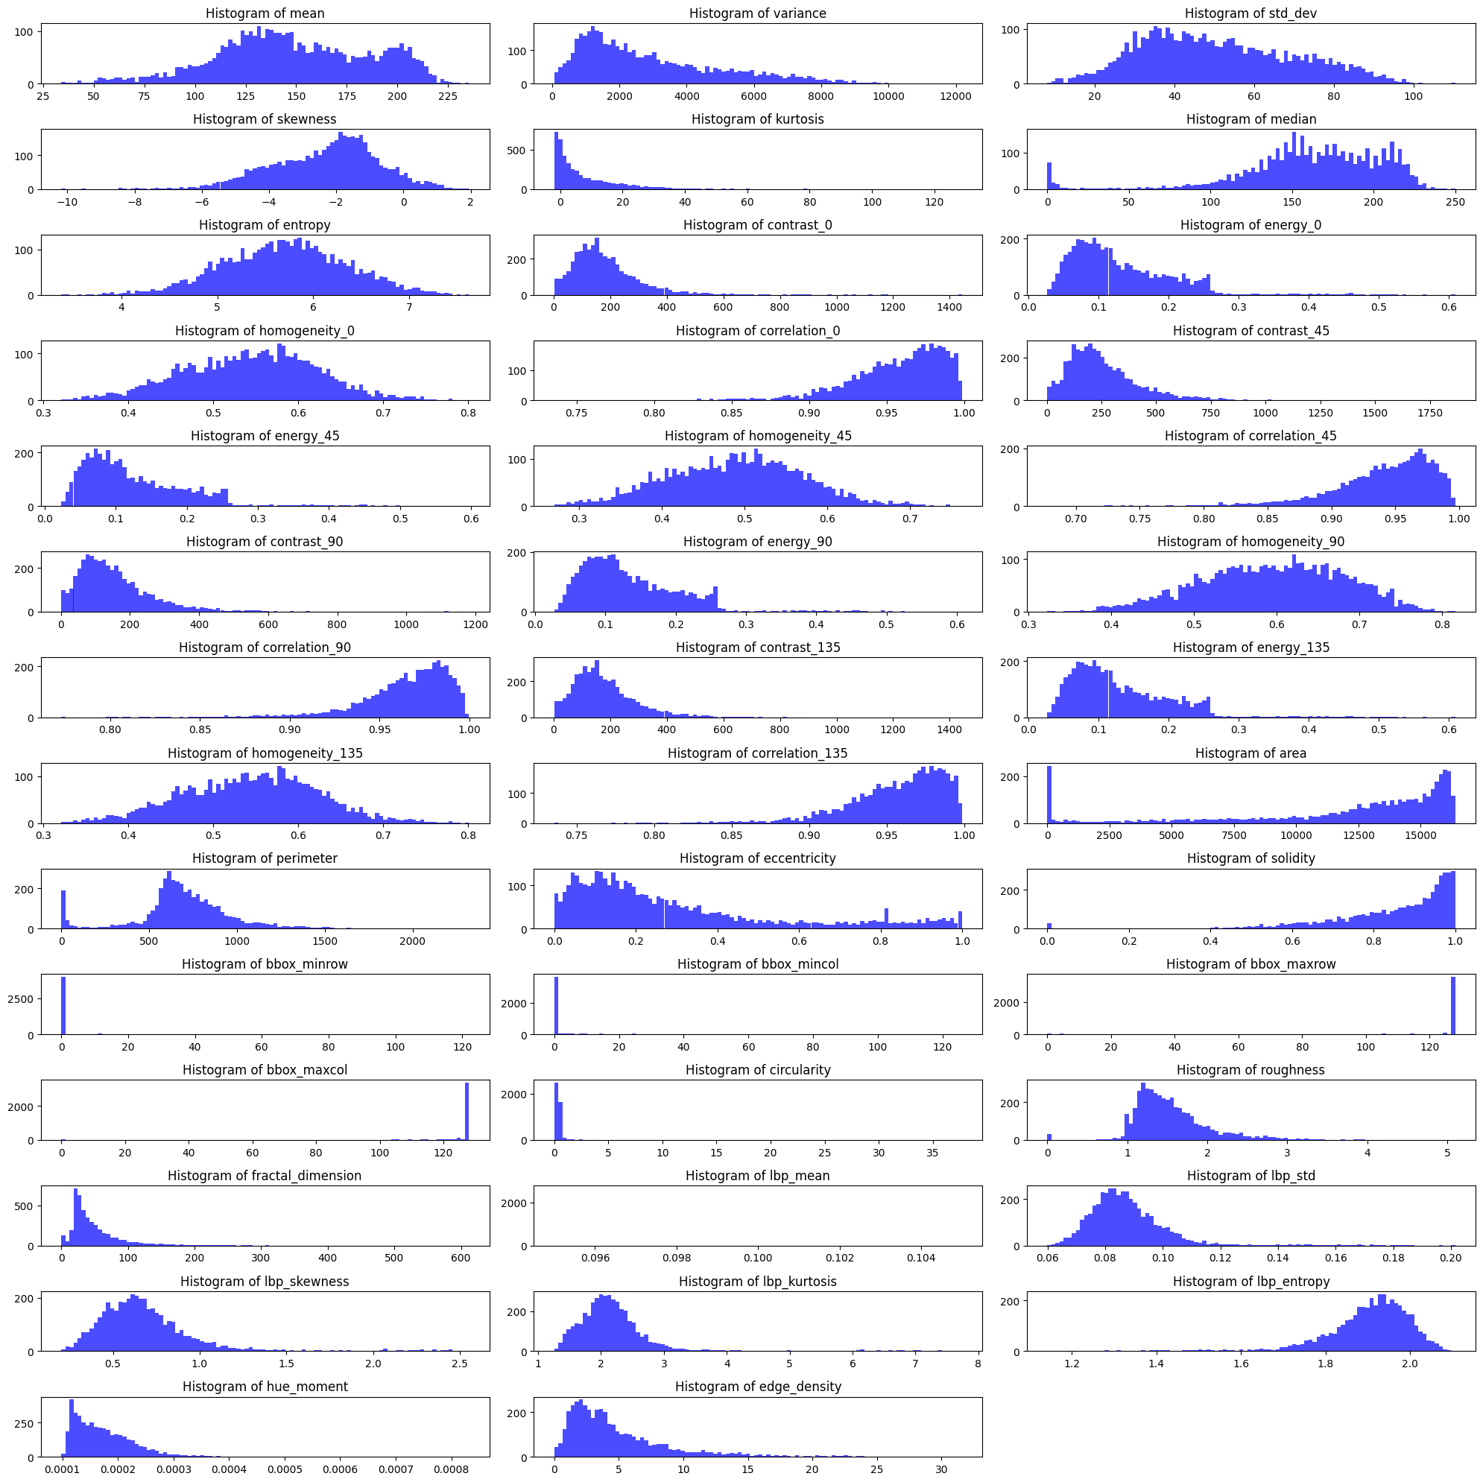
Histogram Data Distribution

Slide 40
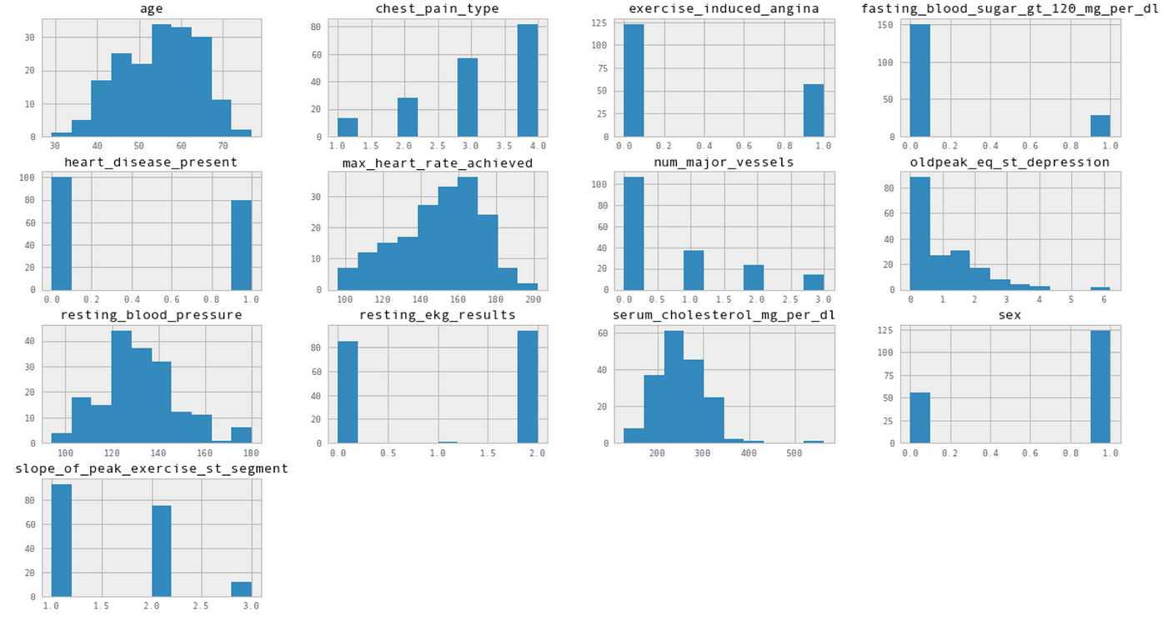
Feature Transformation

Slide 41
Feature scaling and transformation
Feature Transformation
Why Scaling ?
Feature scaling is used to standardize the range of independent variables in a dataset, ensuring no single feature dominates.
It helps models converge faster and perform better, especially for algorithms that rely on distance calculations.
Types of feature scaling:
Normalization (Min-Max Scaling)
Standardization (Standard-Scalar)

Slide 42
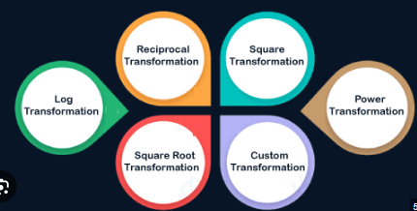


Handling Skewed data Distribution

Slide 43
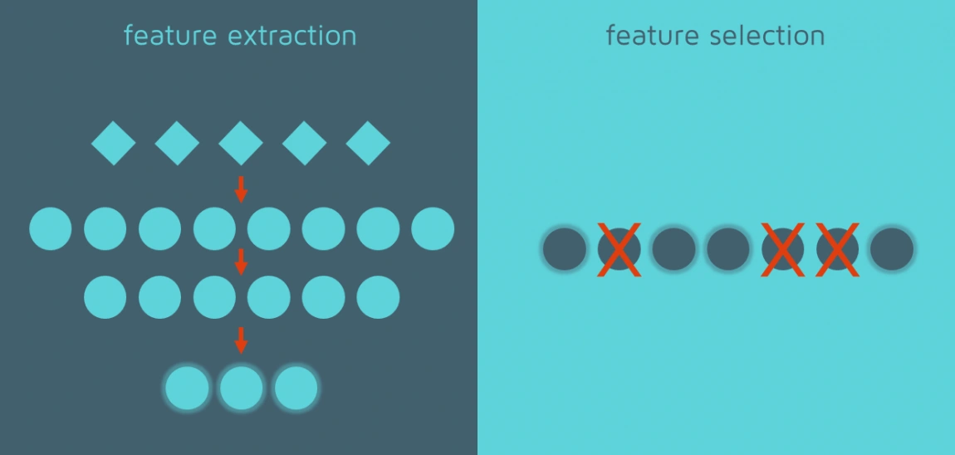
Feature Selection

Slide 44
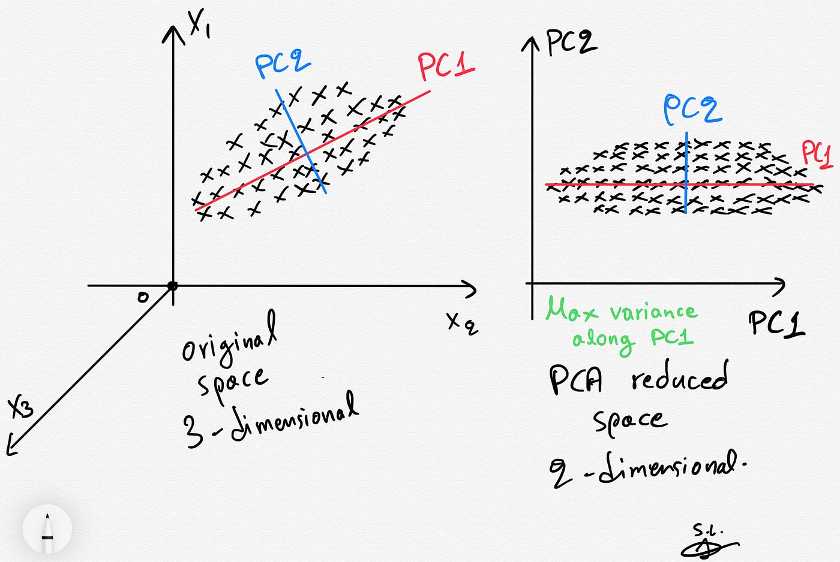
What is principle component analysis (PCA)?
Principal Component Analysis (PCA) is a dimensionality reduction technique used to simplify datasets while retaining as much important information as possible. It transforms the original features into new features called principal components, which are uncorrelated and ordered by the amount of variance they explain

Slide 45

05 Model Building & evaluation

Slide 46
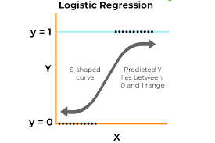
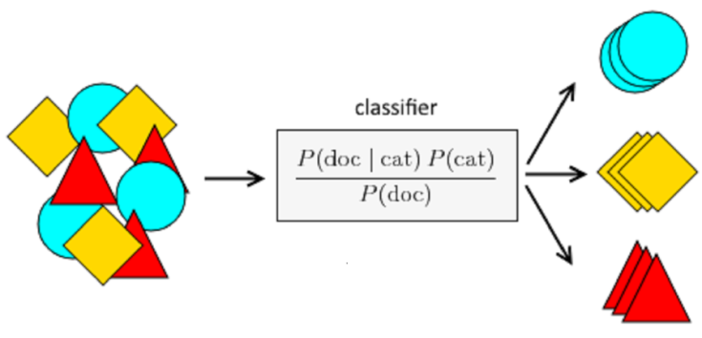
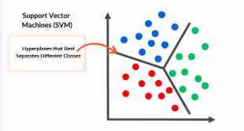
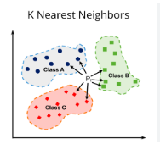
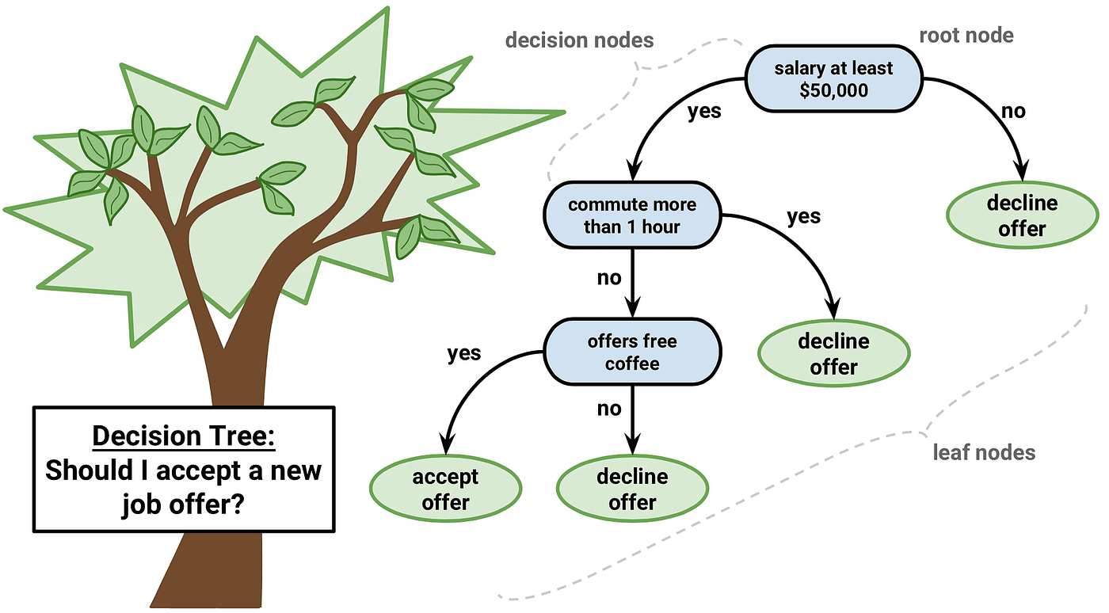
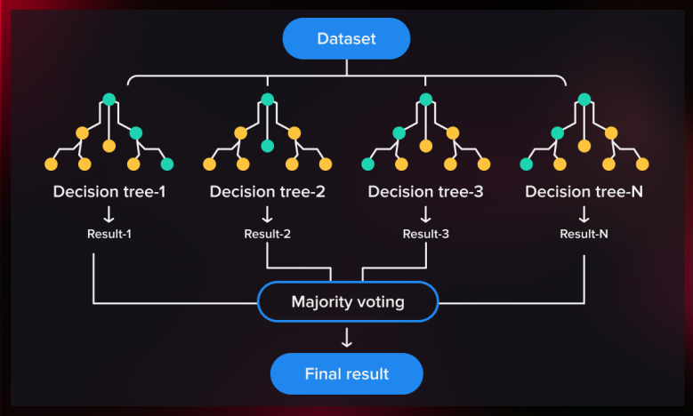
Models

Slide 47
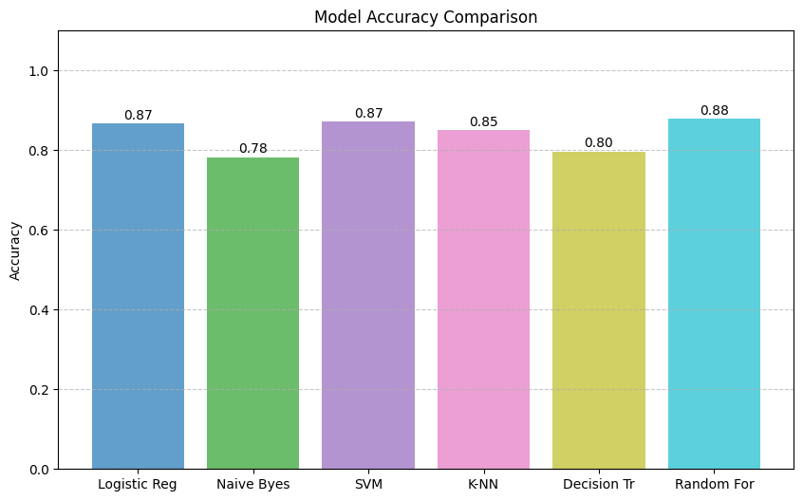
Accuracy

Slide 48
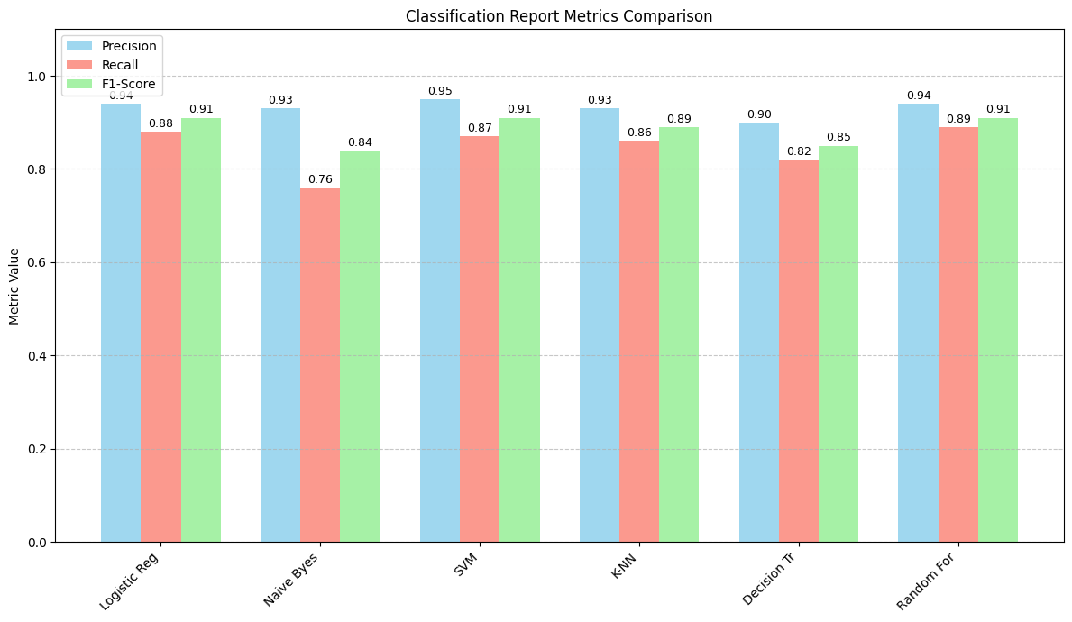
Classification report

Slide 49
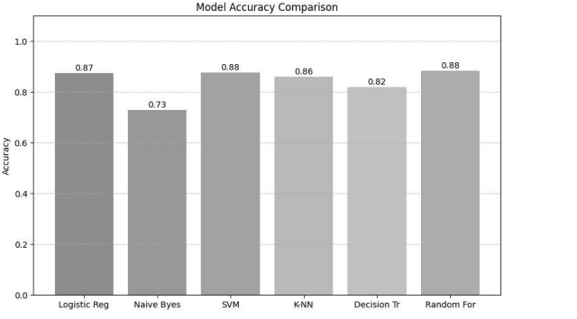
Without segmentation /ROI

Slide 50
06 Performance Comparison

Slide 51
CONT.
Model | Accuracy | Recall | F1-Score | Observation
Logistic Regression | 0.867 | 0.84 / 0.88 | 0.77 / 0.91 | Balanced performance with good recall for both classes. Handles positives (Class 1) better, as seen from fewer false negatives. Slightly lower precision for Class 0.
Naive Bayes | 0.782 | 0.84 / 0.76 | 0.68 / 0.84 | High recall for negatives (Class 0), meaning it identifies most negatives. Lower recall for positives (Class 1) shows more false negatives. Struggles with precision.
SVM | 0.872 | 0.86 / 0.87 | 0.78 / 0.91 | Consistent performance across both classes. High recall ensures minimal false negatives. Precision for Class 1 is high, meaning fewer false positives.
Logistic Regression | 0.867 | 0.84 / 0.88 | 0.77 / 0.91 | - Balanced performance with good recall for both classes. - Handles positives (Class 1) better, as seen from fewer false negatives. - Slightly lower precision for Class 0.
Naive Bayes | 0.782 | 0.84 / 0.76 | 0.68 / 0.84 | - High recall for negatives (Class 0), meaning it identifies most negatives. - Lower recall for positives (Class 1) shows more false negatives. - Struggles with precision.
Model | Accuracy | Recall (0/1) | F1-Score (0/1) | Observations

Slide 52
Model | Accuracy | Recall | F1-Score | Observation
KNN | 0.851 | 0.82 / 0.86 | 0.75 / 0.89 | Slightly lower recall for Class 0 (negatives) compared to other models. Handles positives well but struggles more with negatives. Misclassifies some negatives as positives.
Decision Tree | 0.797 | 0.75 / 0.82 | 0.67 / 0.85 | Good recall for positives but weaker for negatives (higher false positives). Less balanced performance, evident from lower F1-scores. Slightly over-fits to Class 1.
Random Forest | 0.879 | 0.85 / 0.89 | 0.79 / 0.91 | Identifies most positives and negatives accurately (minimal misclassification). Reliable for both classes.

Slide 53
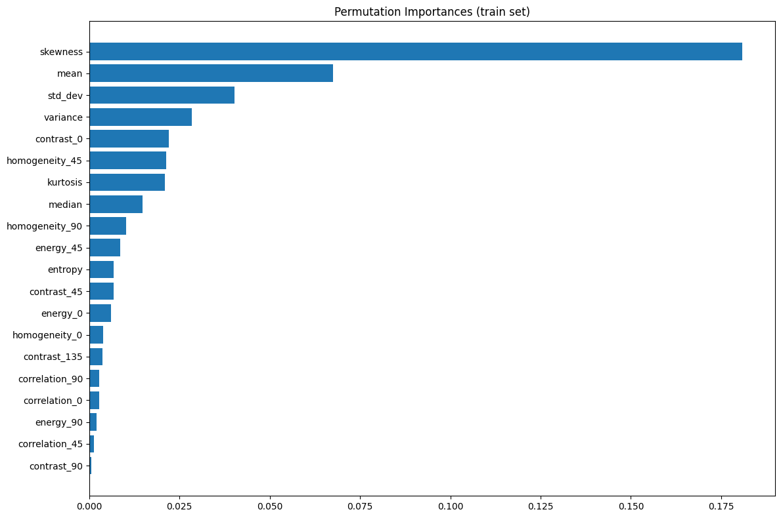
Feature Importance

Slide 54
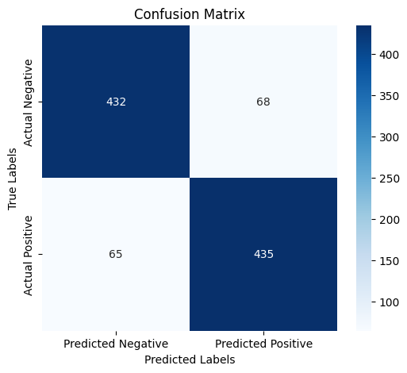
Random Forest
156
29
445
55

Slide 55

6. Conclusion

Slide 56

Based on the analysis, Random Forest is the recommended model for this dataset due to its consistent performance and ability to handle both classes effectively. SVM can also be a good choice as an alternative, particularly for smaller datasets or when computational efficiency is required.

Slide 57

7. References

Slide 58
https://medium.com/@malaka.18/image-smoothing-b3d6a75761d2
https://www.kaggle.com/code/parhammostame/hair-removal-from-skin-images?scriptVersionId=142681556&cellId=3
https://parisrohan.medium.com/feature-transformation-techniques-using-python-fcf36e872bb3#:~:text=Feature%20transformation%20is%20an%20important,algorithms%20are%20of%20no%20use.
https://github.com/ParisRohan/Kaggle_DataScience_Projects/blob/main/rp-pima-diabetes-1-eda-and-feature-transformation.ipynb?source=post_page-----fcf36e872bb3--------------------------------
https://github.com/krishnaik06/Types-Of-Trnasformation/blob/main/All%20types%20Of%20Feature%20Transformation.ipynb?source=post_page-----fcf36e872bb3--------------------------------
https://www.geeksforgeeks.org/principal-component-analysis-pca/
https://www.geeksforgeeks.org/machine-learning-explainability-using-permutation-importance/
https://scikit-learn.org/0.24/modules/generated/sklearn.inspection.permutation_importance.html#sklearn.inspection.permutation_importance

Slide 59


